Slide 1
Source Data
https://data.cityofchicago.org/Public-Safety/Crimes-2001-to-present/ijzp-q8t2
Download full data in CSV
Upload full CSV to AWS
Db=teamsundress
Pw=colorama
Nate
Gather data
Completed 4/30
Upload data
Will complete by eod 4/30
Geomap colorpath by entire timeframe
Eod Friday
Build dash
EOD Tues next week
Build ML on location
Jackie
Use ML to determine if there is a pattern to time and crime (day of week, month, year, week of month year
Pull together our HTML
Javascript
Maria
Create marker clusters for crime overlaid on a polygon

Slide 2
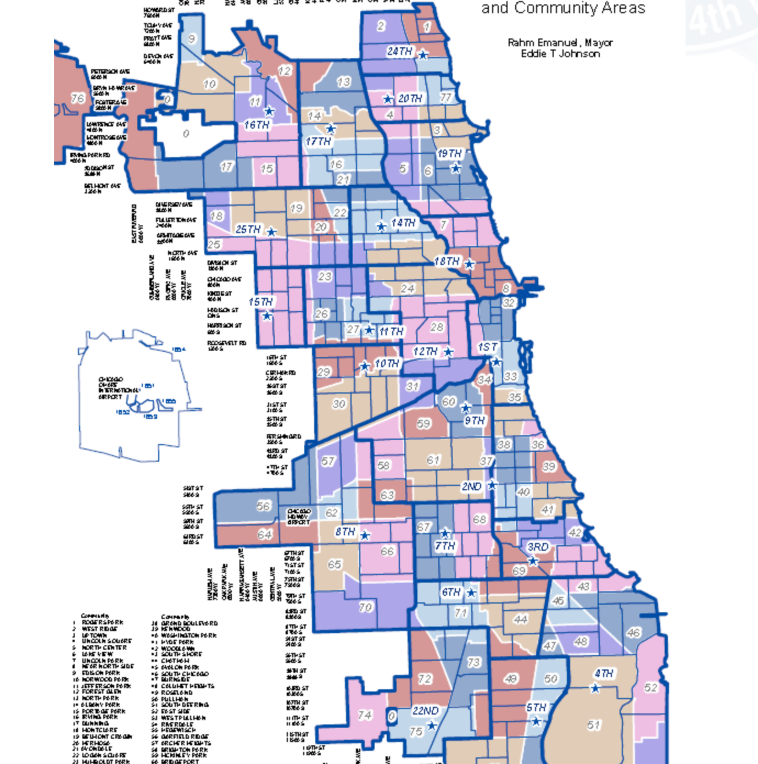
The colors would represent the frequency of crime
The count of crimes in the 77 districts
We would get the polygons from some place
Total from the entire timeframe grouped
Load those to geopandas or R and group by for the count

Slide 3
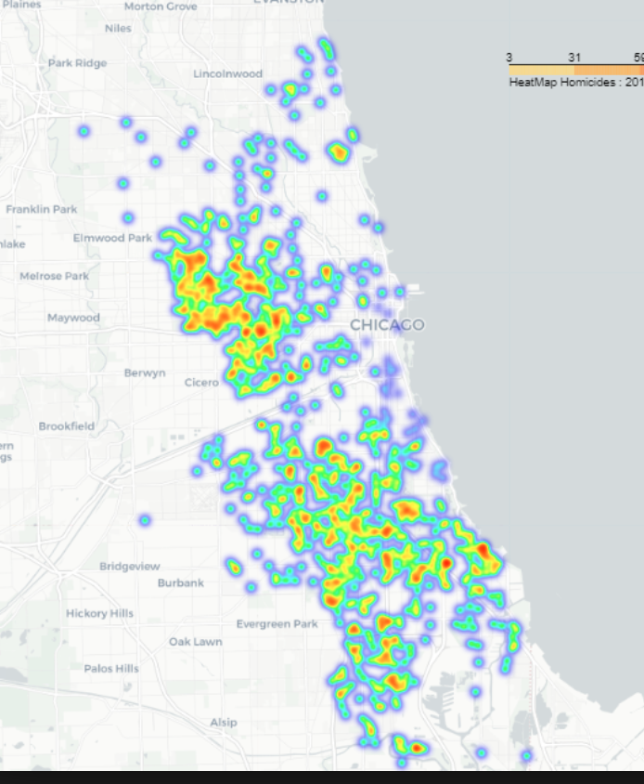
Cluster marker map the individual incodents
This would be over the top of a similar polygon map as the colorpath
We'll figure out some css to use for background

